Slide 1


RDM Lab
Presented by
Steve Diggs (University of California Office of the President)
Shaily Gandhi (PLUS, Salzburg University)
ICTP - Trieste, ITALY: 2024-08-17
Adapted from original material by: S. “Venkat” Venkataraman and NASA TOPS 101
RDM & Open Science: fundamentals

Slide 2

LOGISTICS / TEAMWORK
All activities will be done in your teams
Work in teams of 3 or 4
The slide deck is pre-made and one the blank pages is for your group.
Every group will have a chance to make a final presentation

Slide 3
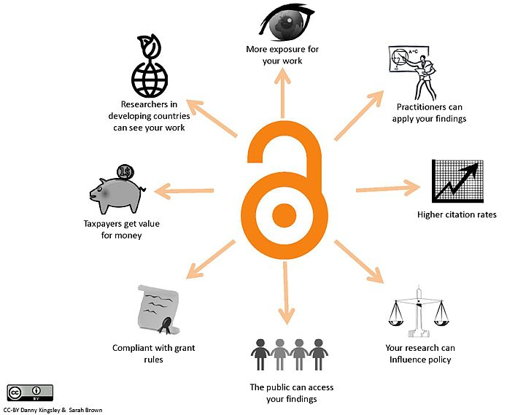
Why is Open Science Important?
Being more open encourages best research practices and makes it easier for you to build on your work.
Open results have more visibility and impact.
Open science encourages more collaborative science.
Figure: There are many benefits of open science. CC-BY Danny Kingsley & Sarah Brown
.

Slide 4
Open Science Can Accelerate the Pace of Scientific Progress
Open science practices accelerate the pace of scientific discovery by involving ideas and labor from the broader community.
The RAPID RESPONSE to the Covid-19 Pandemic showed Open Science in action to accelerate discovery
CITIZEN SCIENTISTS DRIVE NEW RESEARCH METHODS
https://www.nasa.gov/missions/europa-clipper/citizen-scientists-enhance-new-europa-images-from-nasas-juno/
RADAR DATA TO KEEP AN EYE ON CLIMATE CHANGE
https://aws.amazon.com/blogs/publicsector/the-birds-in-the-cloud-how-the-university-of-oklahoma-uses-nexrad-data-to-study-birds/
Notes:
Researchers uploaded the initial genome sequence of SARS-CoV-2 into an open-access database in January 2020, creating a data-sharing precedent and metadata that would later enable insights about new Covid-19 variants. The NIH developed a dedicated platform for sharing research tools for Covid-19 and encouraged investigators to expedite reporting to ClinicalTrials.gov ahead of requirements. Open-science publishing agreements that support evidence dissemination have complemented these practices and policies. One day after the World Health Organization declared Covid-19 a public health emergency, more than 50 academic publishers issued a joint statement committing to open-access policies for Covid-19 research. Support for preprint servers has promoted awareness of research successes and failures, and journals have helped accelerate the distribution of actionable information, including by means of dedicated Covid-19 web pages, endorsement of preprints, and an emphasis on sharing data with public health authorities.
Example of using open science Here is an example of open science that was able to correct errors in a healthcare study quickly, saving lives! In 2021, a study(opens in a new tab) was published that found that Covid stay-at-home policies did not stop transmission of the virus. The study was highlighted by prominent lockdown skeptics and news sites – swiftly gaining the attention of many people right at a critical time in the pandemic. Here was a scientific research article that said lockdowns don’t work! The authors of the study published source code and data with their paper. This allowed others to quickly look at how they arrived at their conclusion. Almost immediately, questions were raised about the paper and within nine months, two papers (https://www.nature.com/articles/s41598-021-02461-2) and here(https://www.nature.com/articles/s41598-021-02096-3) pointed out major analysis method errors. The original paper was retracted. We all make mistakes. In this case, the paper had major policy implications and because the original authors had practiced open science, the error was rapidly corrected.

Slide 5
Group Activity
Think about Open Science (10 min)
In this activity reflect on your answers to the questions and then compare your thoughts with others in the class
In your field, what steps are being taken to increase openness, and what stands in the way?
What could help to increase openness?
What stands in the way?
What is the Benefits to You ?
Can you find your own previous work, post-publication and/or pre-publication?
Can you bring your research materials (data, code, results) with you if you change institutions?
Can you find the work of your collaborators? Of scientists in other fields that you find interesting?
Have you reached out to others to collaborate with them after finding interesting results?
Are people in your field giving and getting credit for work done?

Slide 6
Activity: Think about Open Science (10 min)
(Groups of 3 or 4)
In this activity reflect on your answers to the questions and then compare your thoughts with others in the class
In your field, what steps are being taken to increase openness, and what stands in the way?
What could help to increase openness?
What stands in the way?
What is the Benefits to You ?
Can you find your own previous work, post-publication and/or pre-publication?
Can you bring your research materials (data, code, results) with you if you change institutions?
Can you find the work of your collaborators? Of scientists in other fields that you find interesting?
Have you reached out to others to collaborate with them after finding interesting results?
Are people in your field giving and getting credit for work done?

Slide 7
Activity: Think about Open Science (10 min)
(Groups of 3 or 4)
In this activity reflect on your answers to the questions and then compare your thoughts with others in the class
In your field, what steps are being taken to increase openness, and what stands in the way?
What could help to increase openness?
What stands in the way?
What is the Benefits to You ?
Can you find your own previous work, post-publication and/or pre-publication?
Can you bring your research materials (data, code, results) with you if you change institutions?
Can you find the work of your collaborators? Of scientists in other fields that you find interesting?
Have you reached out to others to collaborate with them after finding interesting results?
Are people in your field giving and getting credit for work done?

Slide 8



Persistent Identifiers (PIDs)
A digital persistent identifier (or “PID”) is a “long-lasting reference to a digital resource” that is machine-readable and uniquely points to a digital entity.
A persistent identifier used to cite data, software, journal articles, and other types of media (including presentation slides, blog posts, videos, logos, etc.). | An “Open Researcher and Contributor Identifier” (ORCID) provides valid information about a person. | The Research Organization Registry (ROR) is a global, community-led registry of open persistent identifiers for research organizations
https://www.doi.org/the-identifier/what-is-a-doi/ | https://orcid.org/ | https://ror.org/about/

Slide 9
Activity: Explore Zenodo and Sign Up! (15 min)
One of the leading generalist repositories at the moment is Zenodo.
Zenodo is an example of a data repository that allows the upload of research data and creates DOIs.
Explore open repositories to familiarize yourself with their structure and available product information.
Optional - Review the following 4.5-minute video (https://www.youtube.com/watch?v=BPVSErzNtME&t=22s ) to get an overview of Zenodo and then sign up for an account.
You can use your ORCID to sign up if you have one or made one in a previous lesson.

Slide 10
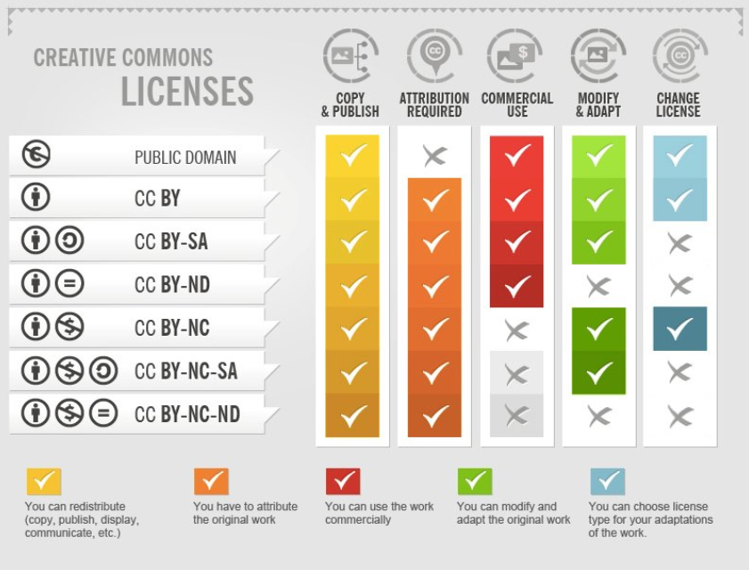
Licenses for Research Data
Provide information to any potential data reuser of their rights
Ensures clarity
Creative commons (CC) licensing most used in research
Part of How To Attribute Creative Commons Photos by Foter, licensed CC BY SA 3.0
Notes:
The ability to reuse data is something that is a very common need in research. Frequently you are building upon prior research or you simply want to compare your own results with that of similar data. Whatever the reason, reuse of data can only be achieved if that data has been licensed properly. While you may have seen the copyright symbol frequently in use in a number of scenarios in everyday usage, and perhaps also things that are deemed “public domain”, there are times when you will encounter licenses that are in between. In the fields of research data, these are usually Creative Commons licences that lie on a spectrum of “openness”. For all research that is publicly funded and that is not sensitive in nature, it is strongly recommended that you license your data using one of the most open CC licences such as CC-BY or even CC-0. There may also be a mandate from your funder and/or host institution on how your data should be made available to others and it is increasingly common for these to be using more open licences - please check with your funder and institution for which you may need to use!

Slide 11
More about Licenses
Licenses can be applied to data, code, and reports, or publications, and almost any other “creative” output. There are also several different types of licenses and also the case where no license need to apply:
Permissive Licenses allow users a wide range of rights including the ability to use, modify, and distribute the work with no restrictions or very few. Examples of permissive license would be open source software license such as Apache 2.0 or MIT license or the Creative Commons licenses such as Creative Commons Attribution (CC-BY)( https://creativecommons.org/licenses/by/4.0/). Protective Licenses are a legal technique of granting certain freedoms over copies of copyrighted works while including some limitations. This may include copyleft licenses, commercial licenses, or other restrictions.
Public Domain is not a license, but it is an indication that there are no reuse restrictions on the work. Creative Common Zero(https://creativecommons.org/licenses/by/4.0/) is a worldwide public domain mark that indicates that the material is free to use without any restrictions.

Slide 12
Review
Proper Data Management can:
Increase value
Increase reproducibility
Increase provenance
Increase integrity
Increase accountability
Reduce risks
Reduce costs
Reduce fraud
Notes:
To recap, these are some of the ways to ensure good RDM practices are being undertaken and why they will benefit you. And that really is a key point to remember that this is as much for your own benefit than anyone else’s! You will be preserving and safeguarding your research. You will also be embracing an ongoing movement that is growing rapidly around the world and which will have huge societal and financial impacts.

Slide 14
Steps for Planning Outputs in Advance
Speaking about it and organizing with your research team
Deciding which tools to use
Thinking about authorship and credit
Engaging with relevant stakeholders and research partners, for example, industry, around open science
Identifying repositories for software and data
Identifying journals (or other outlets) for publications
Highlighting these approaches in your grant and much more

Slide 15
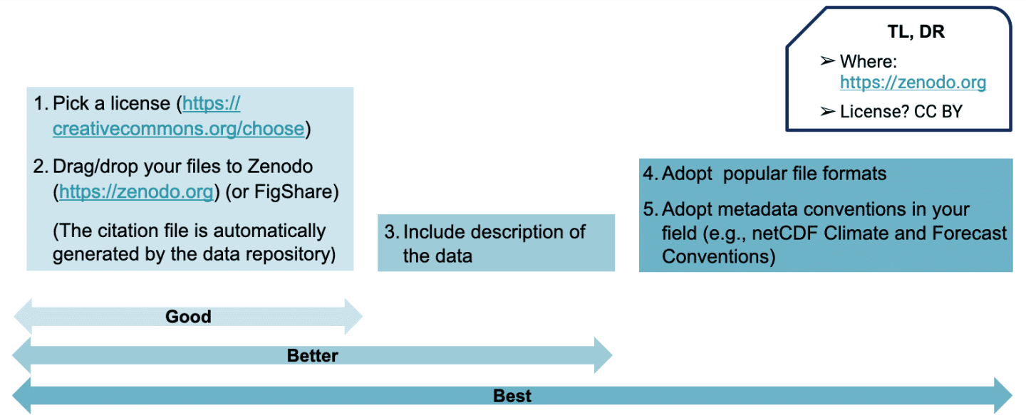
Data Sharing Practice for Zenodo

Slide 16
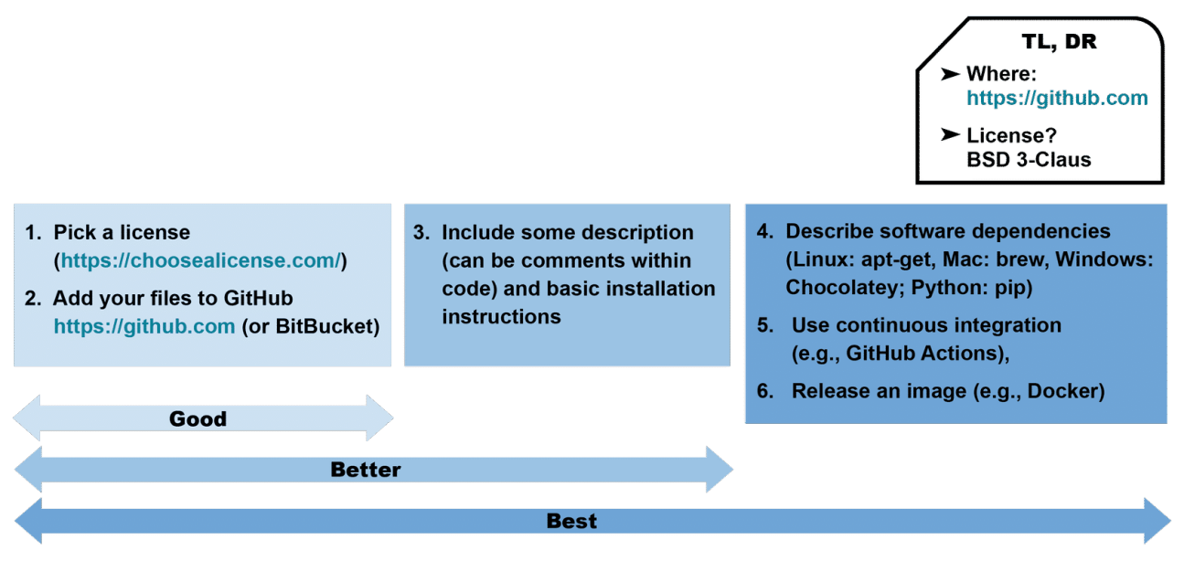
Data Sharing Practice for GitHub

Slide 17
Activity
In this activity, you will search for a DOI for a data set or piece of software that you use, and you will then use the DOI website to “resolve” the DOI name. By “resolving”, this means that you will be taken to the information about the product designated by that particular DOI.
Try the following DOI Numbers
10.9734/jesbs/2022/v35i530421
10.5194/os-13-551-2017
10.1080/10095020.2020.1854981
10.1038/s41586-018-0651-8
10.5067/TERRA-AQUA/CERES/EBAF-TOA_L3B004.1

Slide 18
Open Data Sharing Process
In general, sharing your open data requires the following steps:
Make sure your data can be shared
Select or identify a repository to host your data
Work with your repository to follow their process and meet their requirements
Make sure your data is findable and accessible through the repository and is maintained and archived
Request a DOI for your data set so that it is easily citable
Choose a data license

Slide 19
Activity: How to Enable Reuse of Code
Part 1: Create a test public GitHub repository.
Part 2: Create an archived repository and affiliated DOI.

Slide 20
Part 1: Create a test public GitHub repository
Navigate to the login page for GitHub and login. If you haven’t already, create a free user account.
Create a new repository with this link
Type a short, memorable name for your repository. For example, "os-test".
Set the repository visibility ‘Public’ by selecting this option below the repository description.
In the following section ‘Initialize this repository with:’ select ‘Add a README file’.
Select any license.
Click ‘Create repository’.
You will be automatically directed to your new repository webpage.
Get a DOI from the Zenodo application. We will use:
https://sandbox.zenodo.org/ to do this.
This offers all the same capabilities as https://zenodo.org but is a testing site! Create a free account if you have not already.

Slide 21
Part 2: Create an archived repository
and affiliated DOI
Navigate to the Zenodo GitHub page Click on the button 'Connect' to allow Zenodo to access your GitHub repositories.
Review the information about access permissions, then click ‘Authorize Zenodo’.
Sync your GitHub with Zenodo by clicking 'Sync now' in the upper right corner.
To the right of the name of the repository you want to archive (‘os-test’), toggle the button to On.
Click on the name of the repository.
Click the big green button that has ‘username/os-test’
Add a tag ‘test’. You may have to create a new tag for ‘test’ if prompted.
Scroll down and click the green ‘publish release’ button
Navigate to the Zenodo GitHub page and see the DOI for ‘os-test’
Share your DOI
Zenodo archives your repository and issues a new DOI each time you create a new GitHub release . Follow the steps at "Managing releases in a repository to create a new one.

Slide 22
Thoughts on RDM
Sharing data is very good thing indeed….
BUT - you need to make sure that the data conforms to good data management practice
Should consider if the data (all of it? some of it?) should be open
If you want to share data then it should conform to set of principles…..

Slide 23

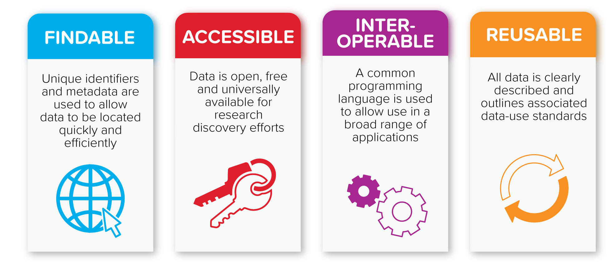
FAIR
Findable, Accessible, Interoperable & Reusable
Part of a growing movement to increase the value of data by ensuring their long term preservation
A distillation of good RDM practices
Notes:
Hopefully, you will have noticed that there were some core messages that were being repeated in the previous slides - findability, accessibility, interoperability and reusability or FAIR. The FAIR principles have existed for the last few years and have gained momentum to such an extent that they are a cornerstone to much of the research being funded in Europe, N America and Australia as well as other territories. There is a strong possibility that you will encounter the FAIR principles in your country and/or institution and that you will be expected to comply with what they recommend. You can think of the FAIR principles as being a formalisation of what good RDM should be and rich metadata are key to making this happen. Importantly, data that are FAIR compliant are not necessarily good data and this should be kept in mind - quality assurance of data is a completely separate task! However, the FAIR principles are an important tool in upholding good research and are as important for humans as they are for machines - please familiarise yourself with them and see how they could benefit you!

Slide 25


Ocean Observations
101

Slide 26
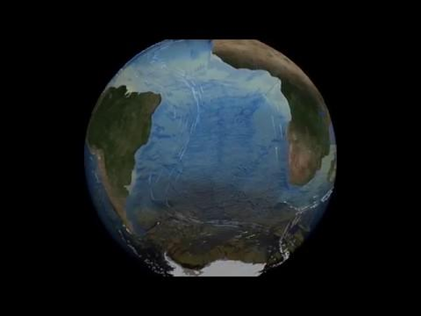
Browser

Slide 27

1.332 x 10^21 Liters of Water
~352 Quintillion Gallons

Slide 28
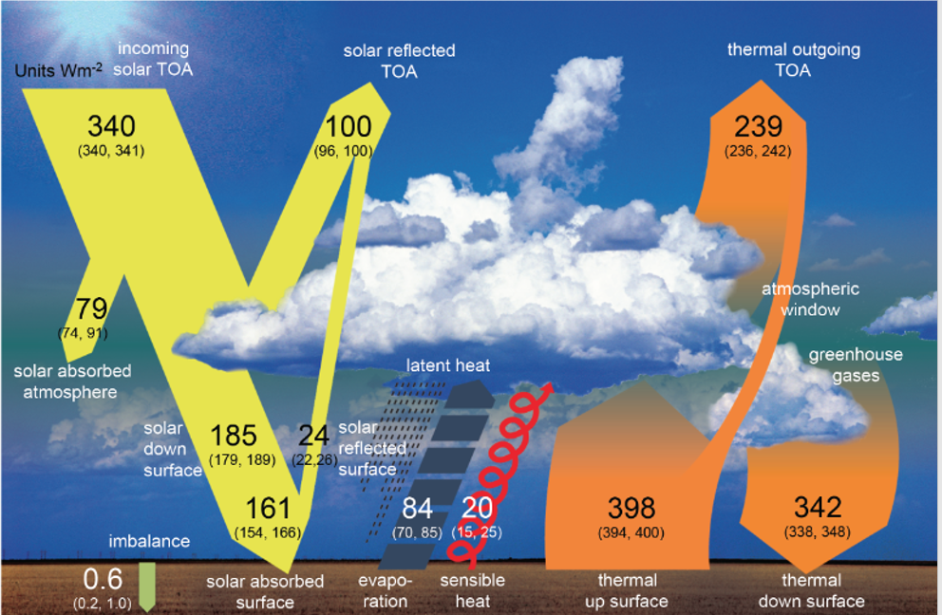
The need for global ocean observations:
Global Ocean Heat Content
Energy fluxes at the top of the atmosphere are accurately measured by satellites, but the net flux is a small difference of large numbers and is challenging.
This net heat flux is more accurately measured from temperature changes of the ocean, atmosphere, and cryosphere.
Earth's heat balance
(Source: IPCC 5th Assessment Report)

Slide 29
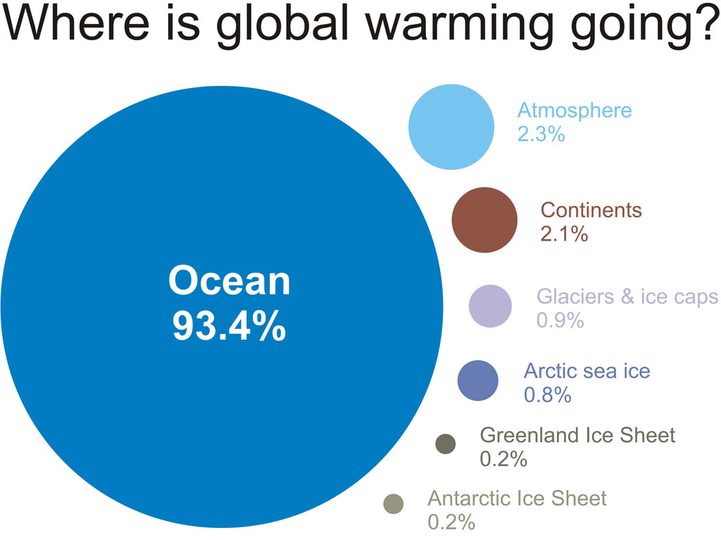
Oceans are the “flywheel of climate”
S. Levitus, J. I. Antonov, T. P. Boyer,O. K. Baranova,H. E. Garcia,R. A. Locarnini,A. V. Mishonov,J. R. Reagan,D. Seidov,E. S. Yarosh, and M. M. Zweng | published 17 May 2012

Slide 30
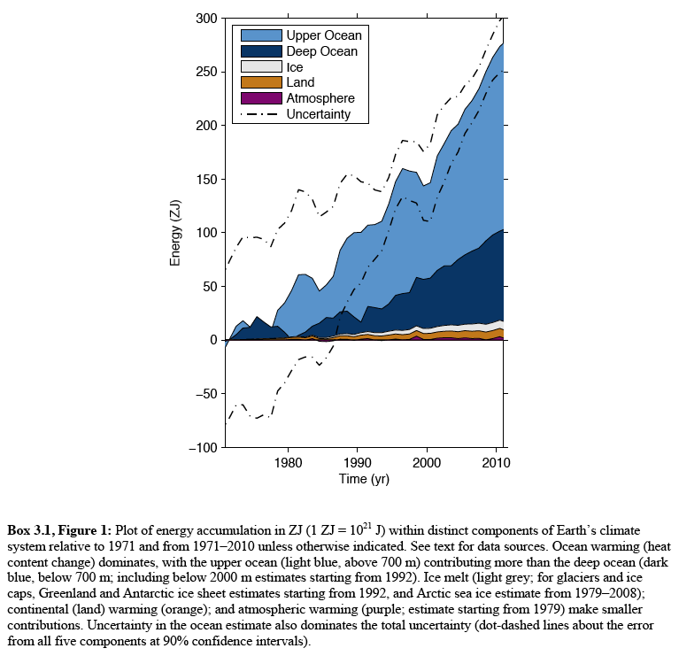
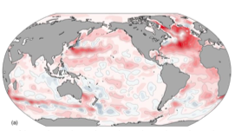
The global energy excess is mostly in the ocean
If the excess heat in the system that is now in the ocean were in the atmosphere, surface air would be 100°C warmer.
Notes:
93% of the Earth system’s excess heat is in the ocean.
16% of the total energy change is in deep ocean > 2000 m, more than double the energy change in the atmosphere, land, ice combined.
When we consider the entire Earth system, the “hiatus” may become a non-issue. The whole system is warming overall.

Slide 31
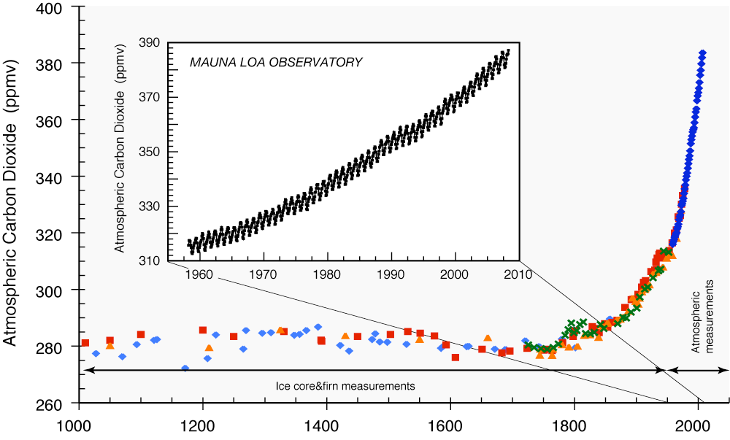
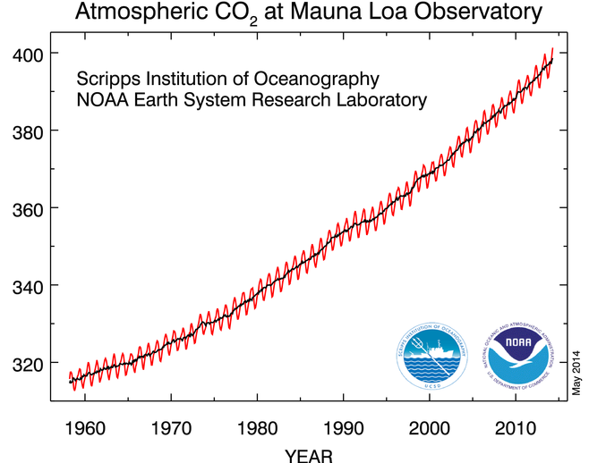
Atmospheric CO₂ was steady for at least 1,000 years
pre-industrial revolution
Increase
2 ppm/yr
Year
Year
Adapted from Sarmiento and Gruber 2002 using Trends online data

Slide 32
Ocean Acidification
Approximately 28% of the CO₂ generated by human activities since the mid-1700s has been absorbed by the oceans.
Ocean acidity has increased 30% since the start of the industrial age.
Ocean acidity is projected to increase 100-150% percent by 2100.
Current rate of acidification is nearly 10x faster than any period over the past 50 million years.
Notes:
Note for 1st bullet: the atmospheric concentration of CO₂ in the atmosphere has increased about 35% since the start of the industrial age (1750s). The current concentration in the atmosphere (~392 ppm) has not been seen for at least 800,000 years (based on ice core data).
Note for 2nd bullet point: a 30% increase in acidity corresponds to a decrease of 0.1 pH units. The pH scale is logarithmic (like the Richter scale), so a small change in pH corresponds to a large change in acidity. For example, pH 7 is 10 times as acidic as pH 8.
Note for 3rd bullet point: This projection is based on the current rate of global carbon dioxide emissions.
Note for 4th bullet point: This rapid rate of change gives marine organisms, ecosystems and humans less time to adapt, evolve or otherwise adjust to changing ocean chemistry. Scientists are concerned that many marine species will not be able to keep pace, and will go extinct.

Slide 33
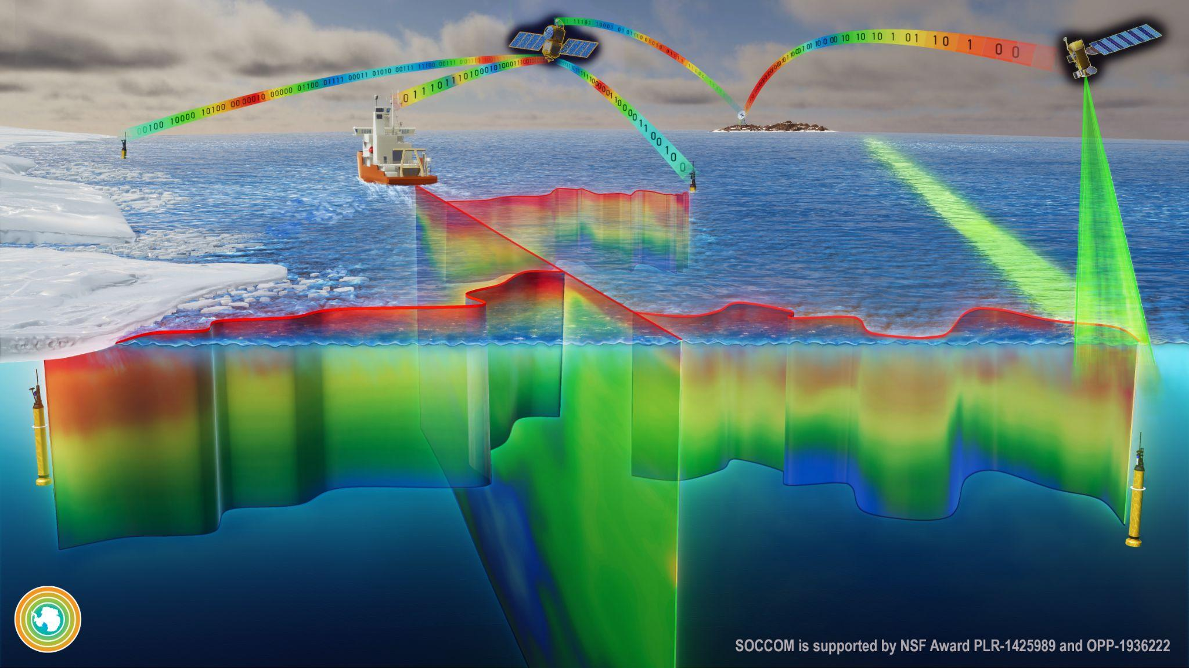

Slide 34
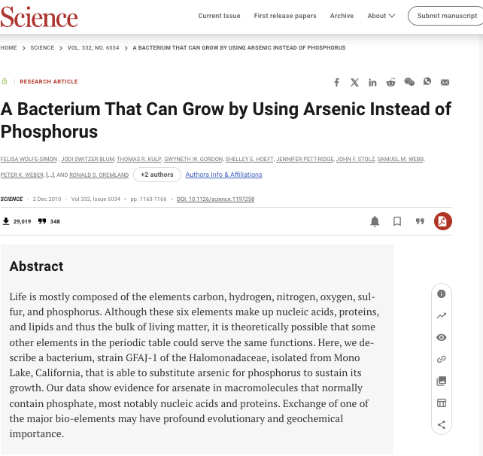
Extra Terrestrial Biology
Research published in 2010 suggested that the bacterium GFAJ-1 could use arsenic instead of phosphorus in its essential biomolecules, like DNA. This was a groundbreaking idea as phosphorus is considered a fundamental building block of life as we know it.
Significance: If true, the claim would have major implications for the search for extraterrestrial life. It would expand our understanding of the conditions under which life can exist and potentially open up new avenues for exploration in environments previously thought to be inhospitable.

Slide 35
Workshop Time

Slide 36
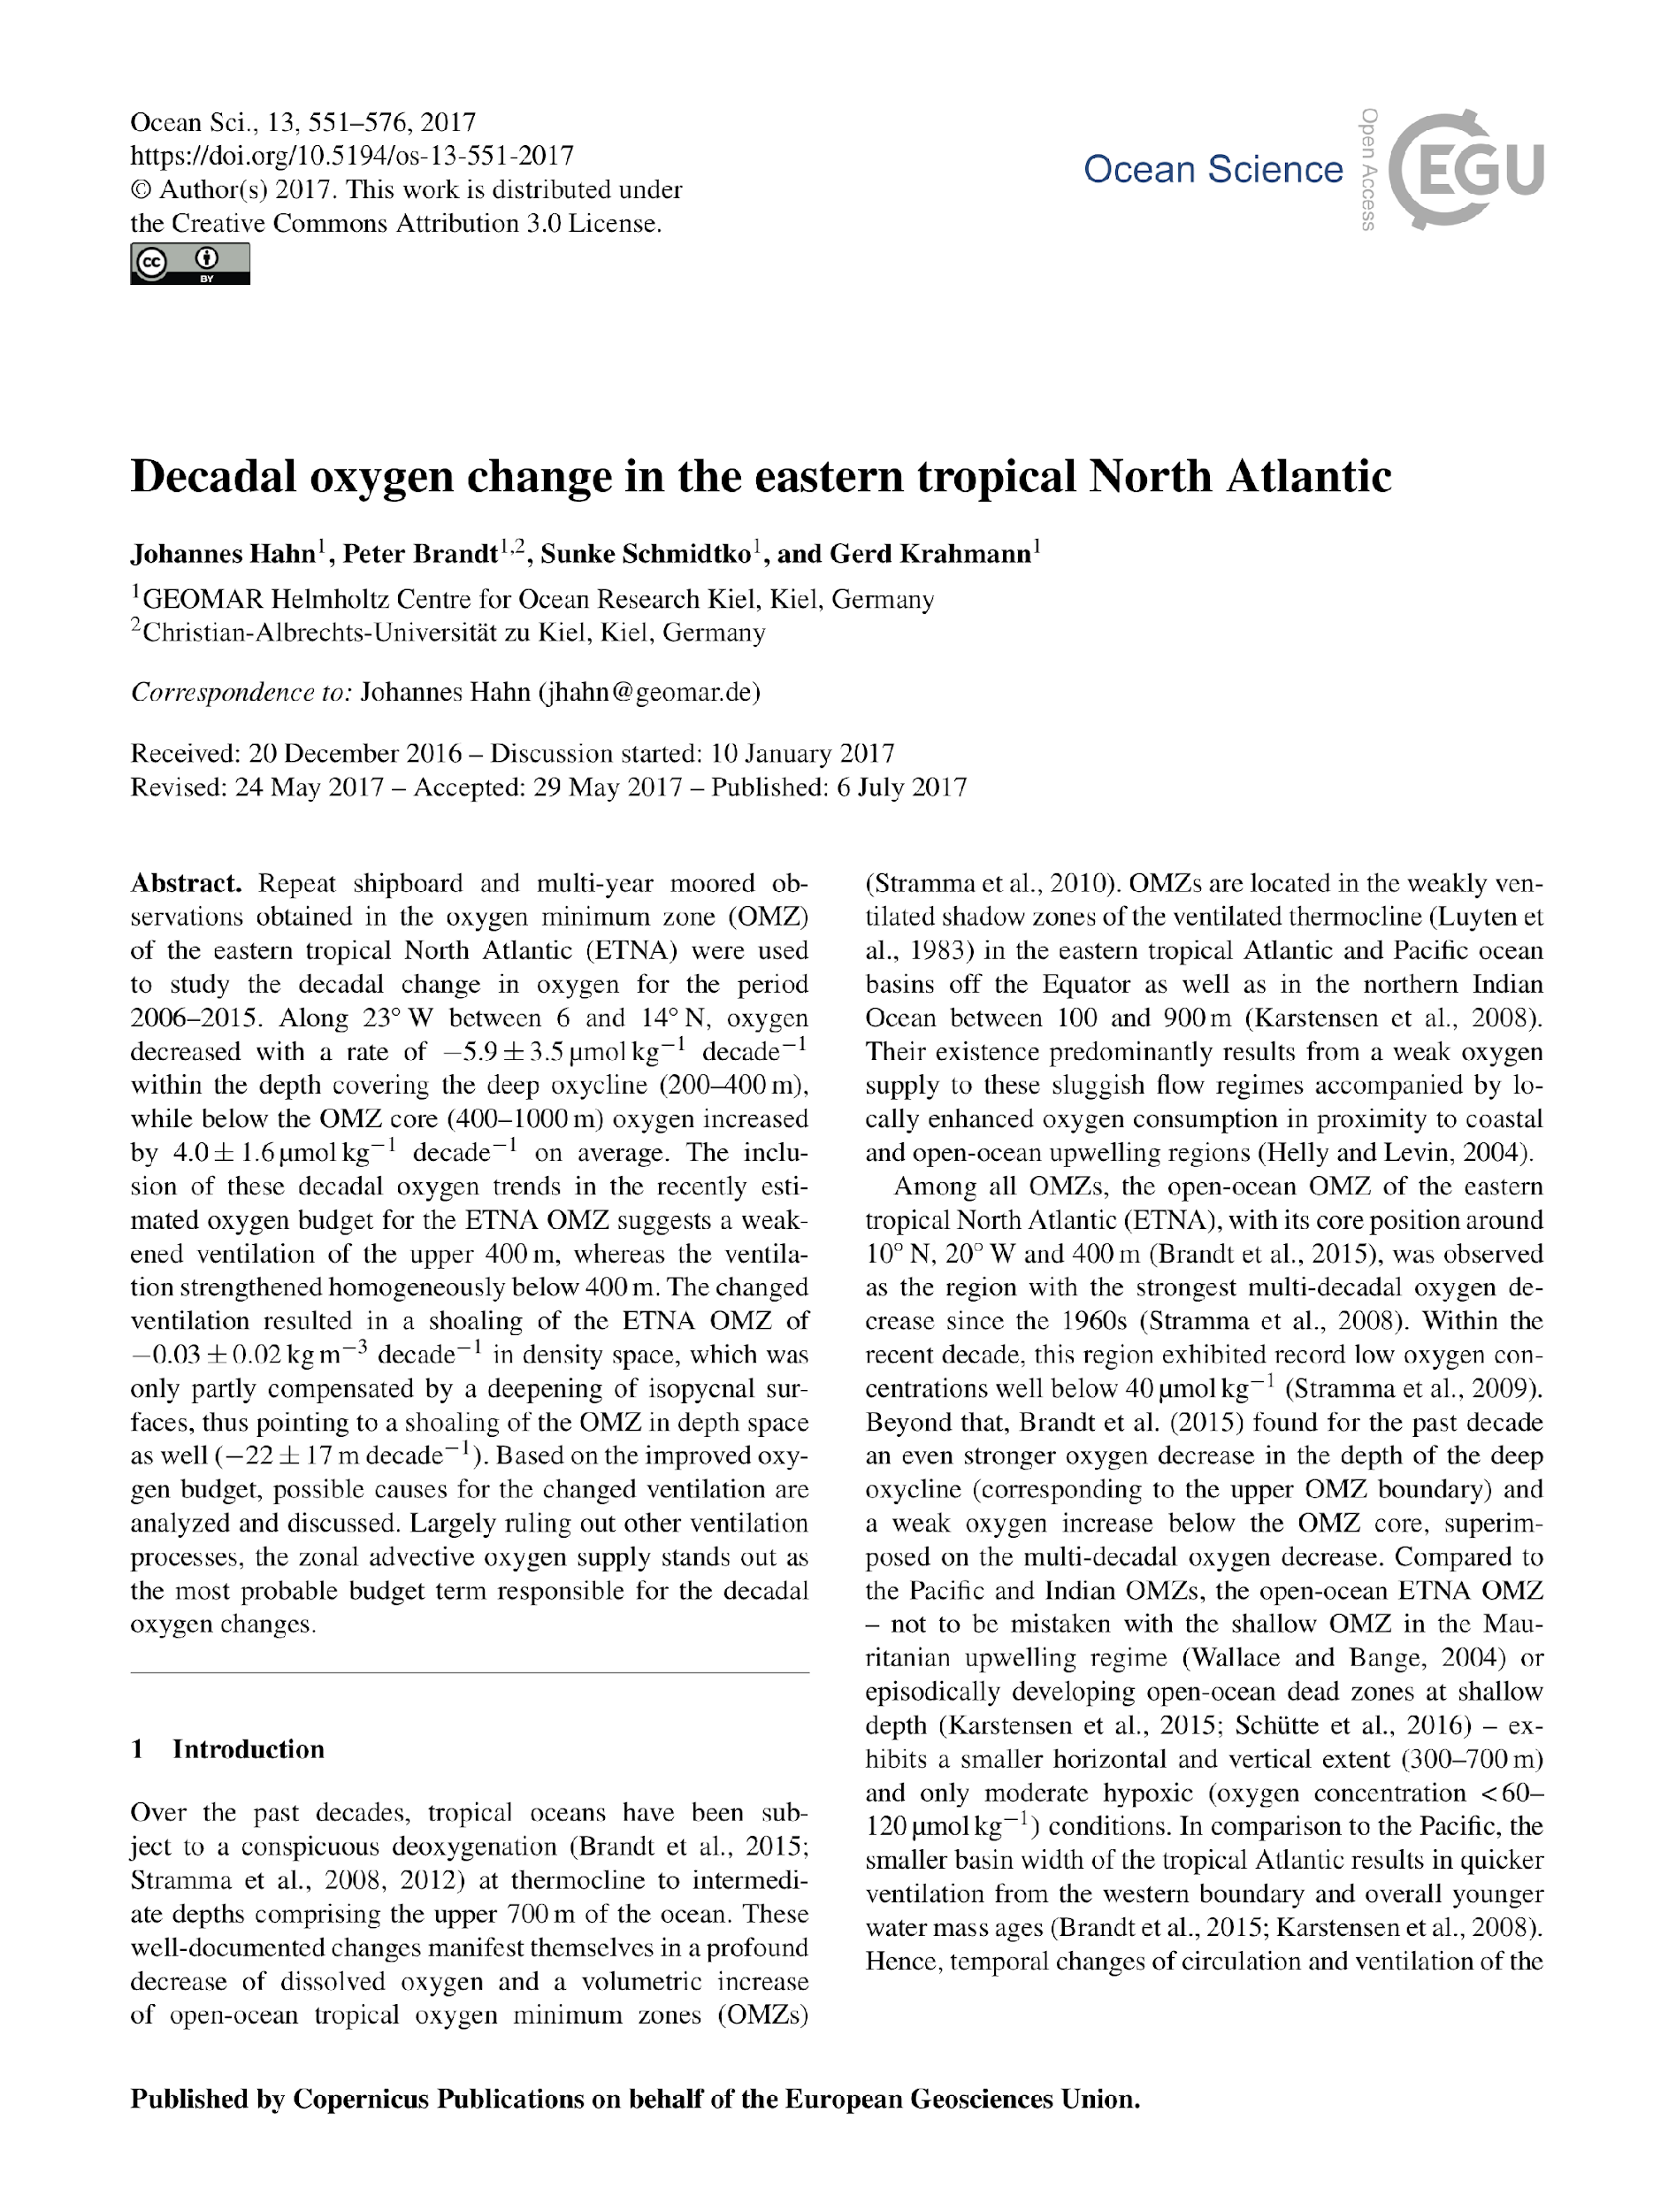
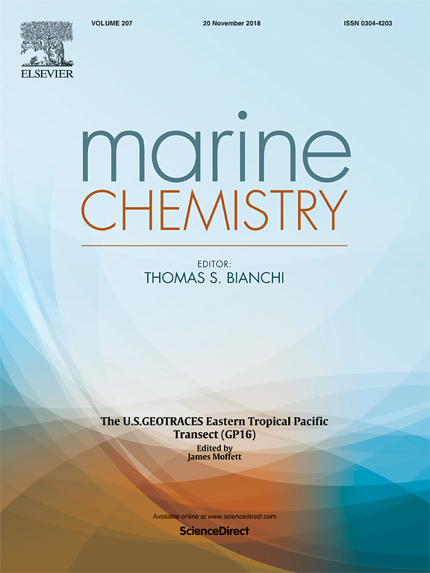
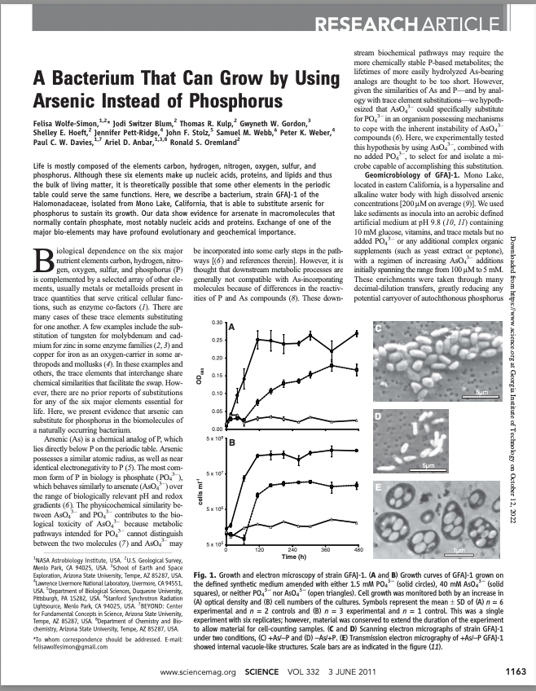


Problem Description: Teamwork!
Your interdisciplinary science team will quickly review one of these peer-reviewed papers
https://bit.ly/2023_RDM_papers
1
3
2
Notes:
https://goo.gl/s9YLFH

Slide 37
Problem Description
Your group has decided to try to replicate the results from the research described in the paper
Your assignment is as follows:
Scan the paper, look for clues as to where the data used in this research might reside
Find and try to download those data
Be mindful throughout of what makes the data easy/hard to:
Locate
Download
READ/UNDERSTAND (possibly with other data)

Slide 38
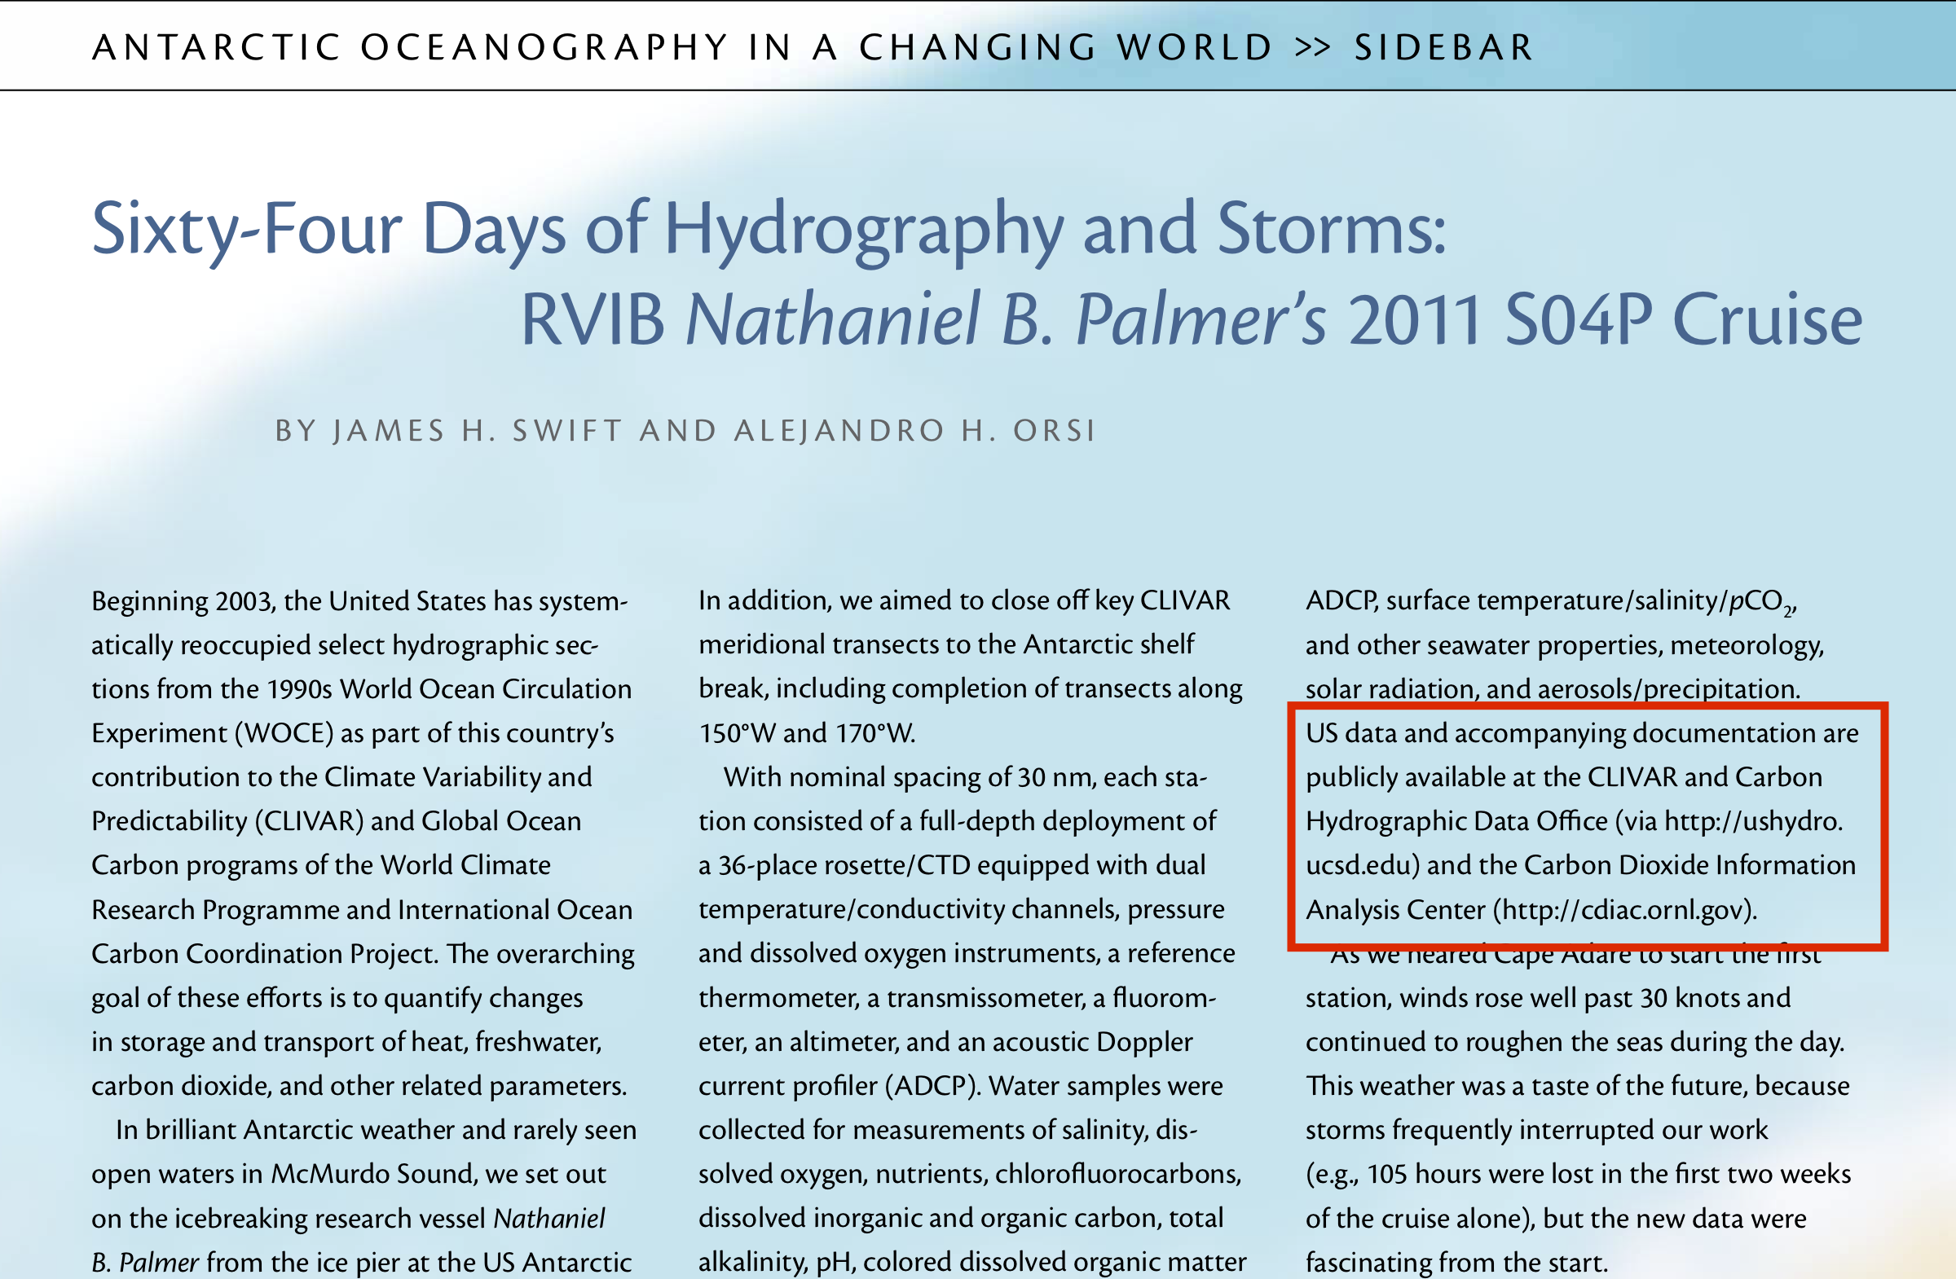
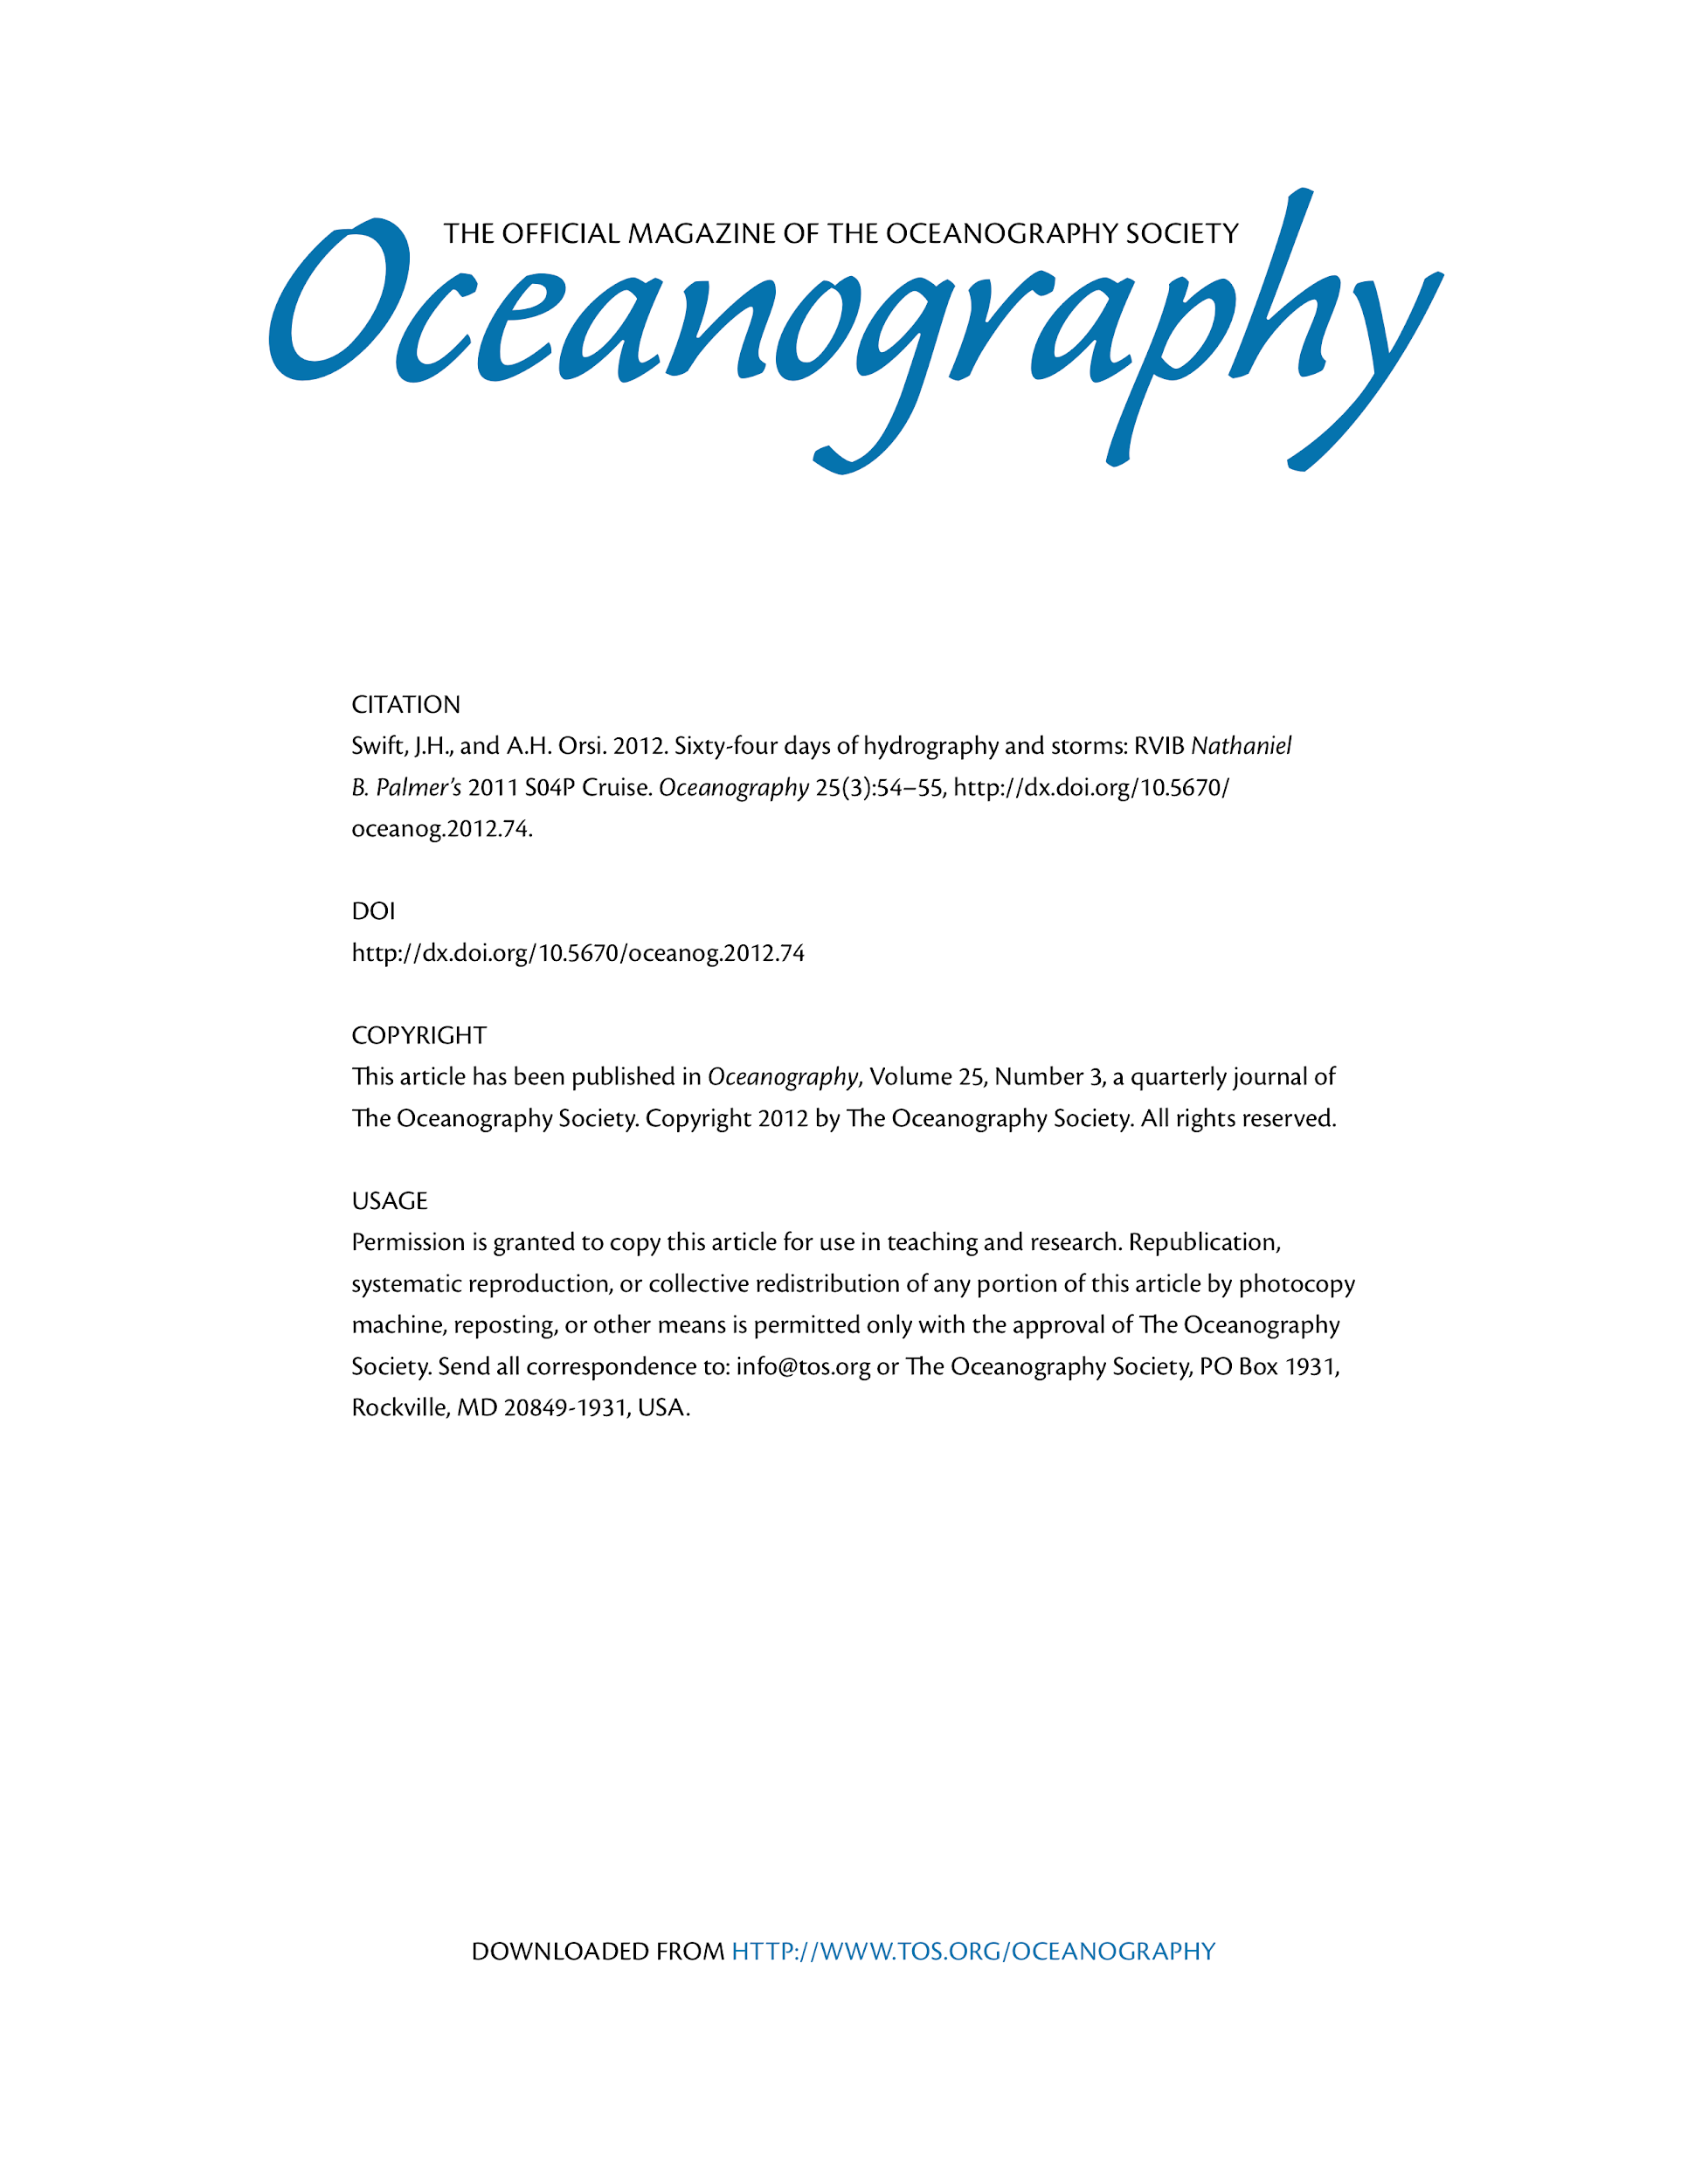
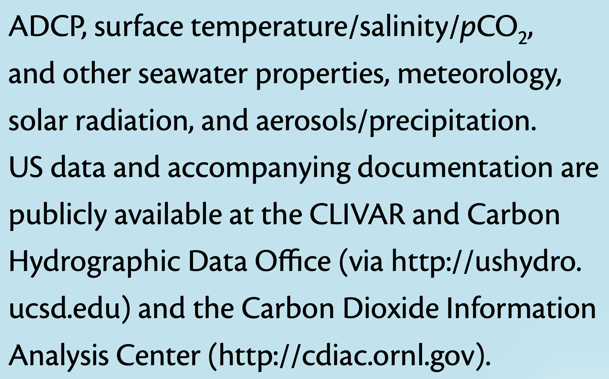
Example

Slide 39
Your Workspace
Use the provided template 1-2 slides on what you found, and be prepared to discuss your findings in about 12 minutes. You can decide on a presenter any time between now and when you present.
https://bit.ly/2023_RDM_papers

Slide 40
Template: Your Team’s Research Data Assessment Report
Our Team consisted of …
Name 1 …. Name N
Persistent Identifier for the data
PID
We found the data we were looking for here:
Name of repository / data center and URL
The data was discoverable/accessible
Were you able to read the data with ODV or other software?
Could not find the data (why?)
Overall FAIRness assessment (1=awful to 10=great)

Slide 41
The Future is Now
Browser

Slide 42
How Emerging Technology Like AI is
Changing How We Do Science
Use of AI for Literature review
The ever-increasing volume of scientific literature has made it challenging for researchers to stay abreast of recent articles and find relevant older ones.
AI tools can be used to create personalized recommendations for relevant articles as well as create summaries of them in various formats.
Some examples of these tools include SciSummary, , SummarizeBot, Scholarcy, Paper Digest, Lynx AI, , TLDR This
Possible drawbacks when using these tools include:
Potential introduction of biases
Insufficient contextual understanding or interpretation
Possible inability to handle complex technical language
Incorrectly identifying key points

Slide 43
AI tools for Code Generation
AI tools can be used to generate code to perform analysis tasks and translate between programming languages. Some examples of these tools include Co-Pilot, , Codex, ChatGPT, and AlphaCode, and NotebookLM (Gemini)
Usage tip: Popular large language models can be used to generate code, but it has been noted by many that breaking down tasks and using careful prompts helps generate better results.
AI tools can be used to generate text, summarize background materials, develop key points, develop images and figures, and conclusions. Using these tools may help non-native speakers communicate science in different languages more clearly. Additionally, they could be helpful to develop plain-language summaries, blog posts, and social media posts.

Slide 44
AI tools for science
AI tools for science are developing rapidly.
The science community’s understanding of how to ethically and safely use AI is just developing as its use in research expands rapidly.
The guidelines above offer a snapshot in time and will likely continue to evolve.
If you choose to use these tools for scientific research, carefully consider how much to rely on them and how their biases may impact results, as cautioned in this Nature article.
The internet has transformed the world and AI tools are likely to do the same. As with any tool, it is important they are used for the appropriate purpose and in an ethical manner.

Slide 45
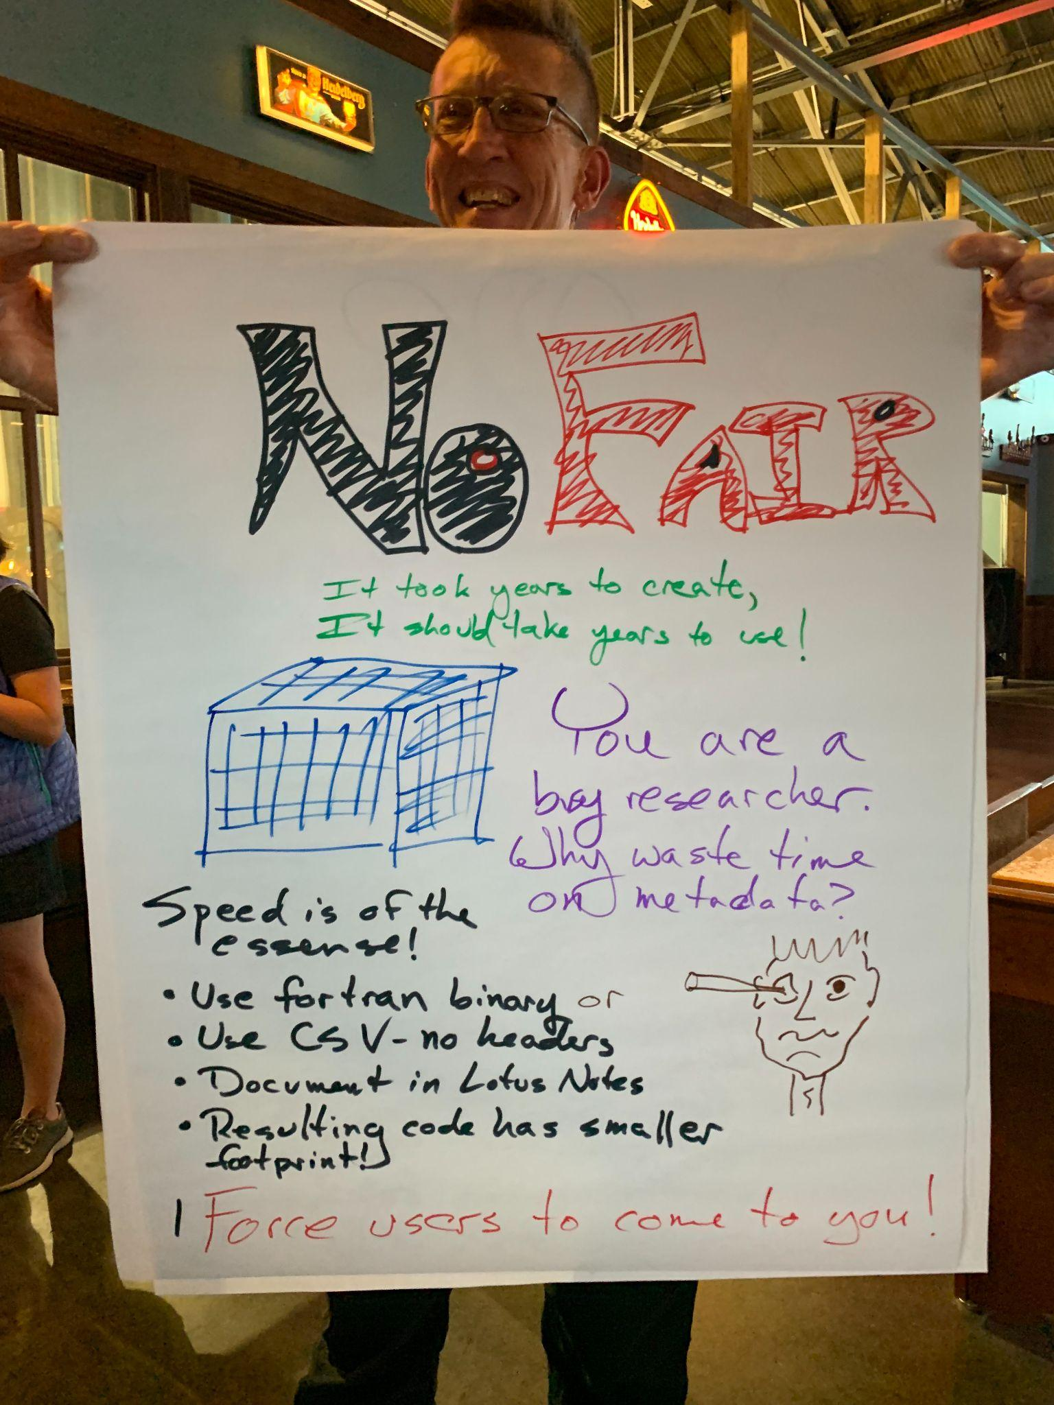
Browser

Slide 47
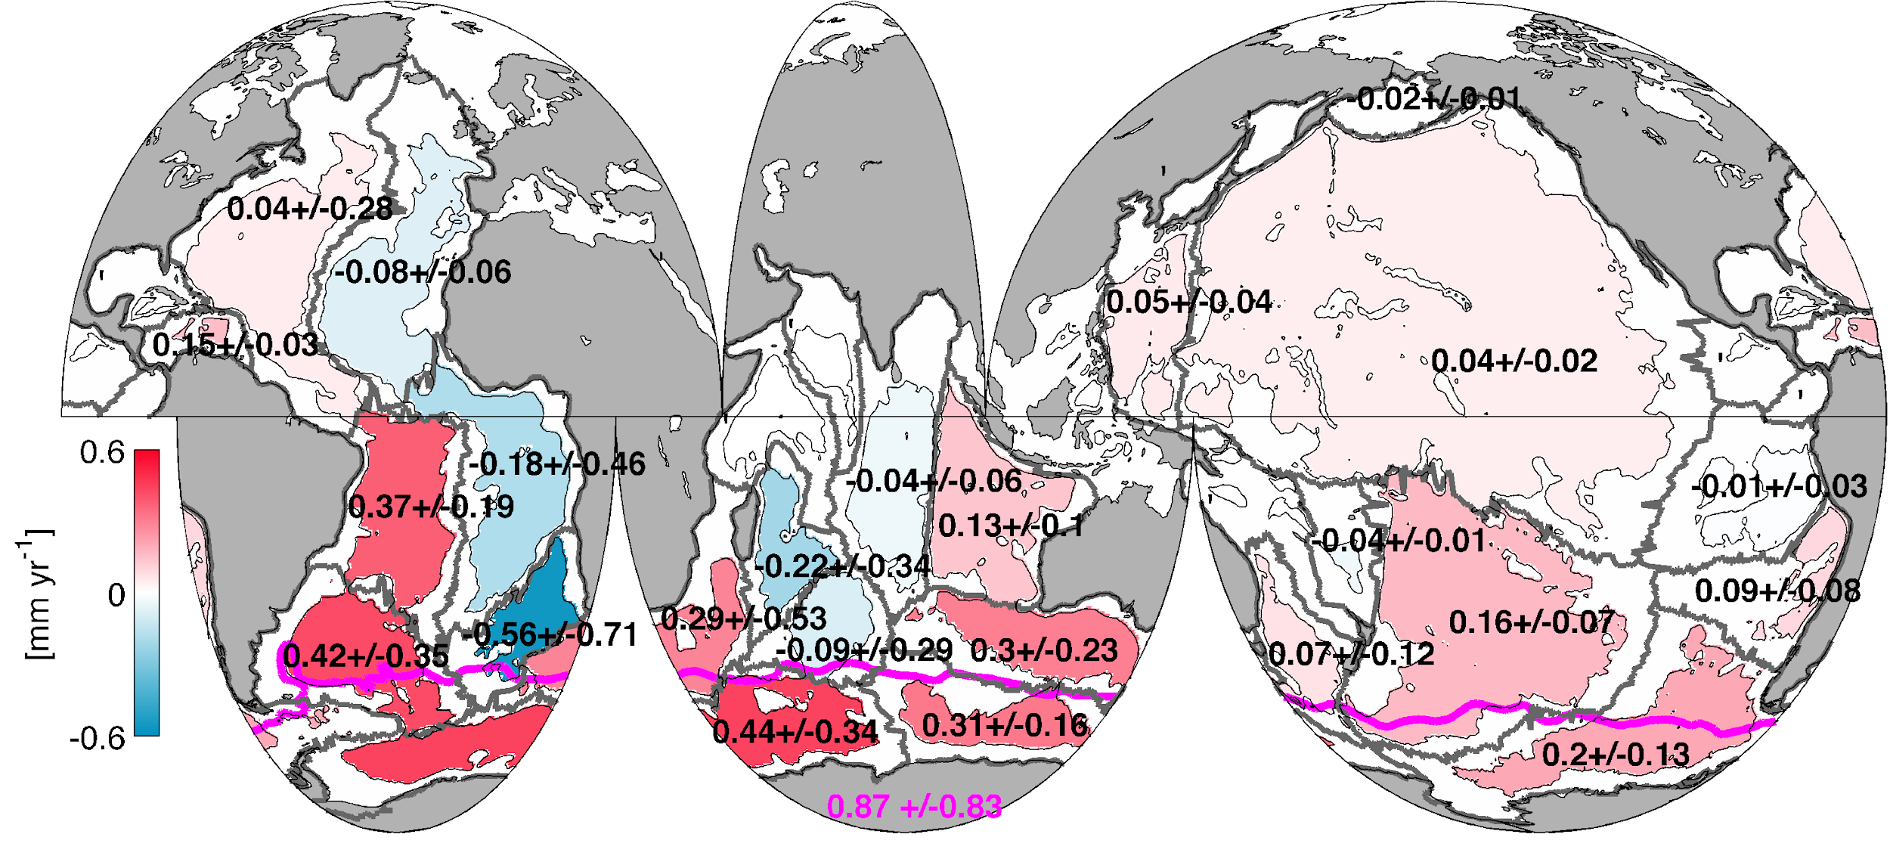
Comparisons and Connections
GO-SHIP CTD data are inputs to the OWC algorithms that are used to estimate the time-varying correction of conductivity measurements from Argo floats.
Bottom Water warming from 1990’s to 2000’s
Purkey and Johnson (2010)

